Slide 1
Prediction of Food Preparation Time
By: Rutvik kumar
Roll no: 19CE02026
Manager: Aditya Dutta(Senior Data Scientist)
Mentor: Alam Hanza (Data Scientist at Gojek)
Company: Gojek

Slide 2
Content
Prerequisites
Problem statement.
Solution
Application of Machine Learning in Civil Engineering
Learning Through This Internship
References

Slide 3
Prerequisites
SQL : Querying and Manipulation
a. MySQL,
b. PostgreSQL
c. Oracle SQL
d. Google Bigquery
Machine Learning
a. Data
b. Algorithms
c. Model Evaluation and Improvement
d. Supervised, Unsupervised, Reinforcement

Slide 4
Problem statement
Create a model to estimate the time needed by merchant to prepare food for a certain order, considering order time, merchant attributes (location, food type, etc.), and historical food preparation time.
Possible use cases on product implementation:
-> GoFood Pick Up ETA
-> GoFood Delay Dispatch (to be built, for back end allocation trigger after order placed)

Slide 5
Solution
Path to be Followed.
Pre-Analysis of data.
Modelling and Evaluation.

Slide 6
1) Path to be Followed
Predicting food preparation time using item_list feature.
Create bucketing of food preparation time (prediction on time bucket instead of numerical value)
Creating model using FPT-realtime and historical features.
Using XGBoost and ANN for modelling.

Slide 7
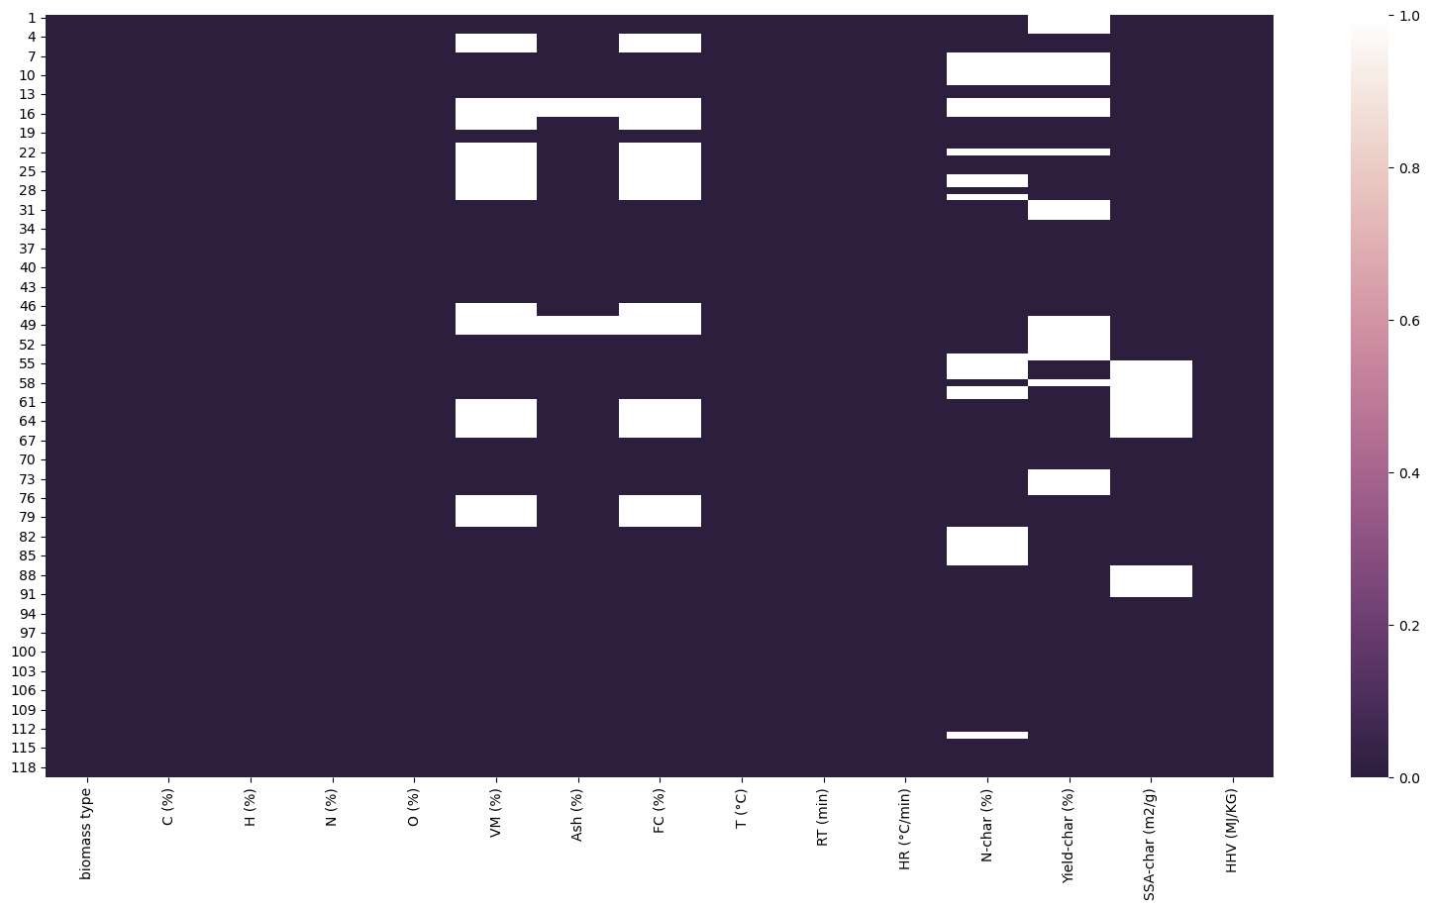
2) Pre-Analysis
HeatMap: A heatmap for null values is a graphical representation that visually highlights the missing or null values within a dataset.

Slide 8
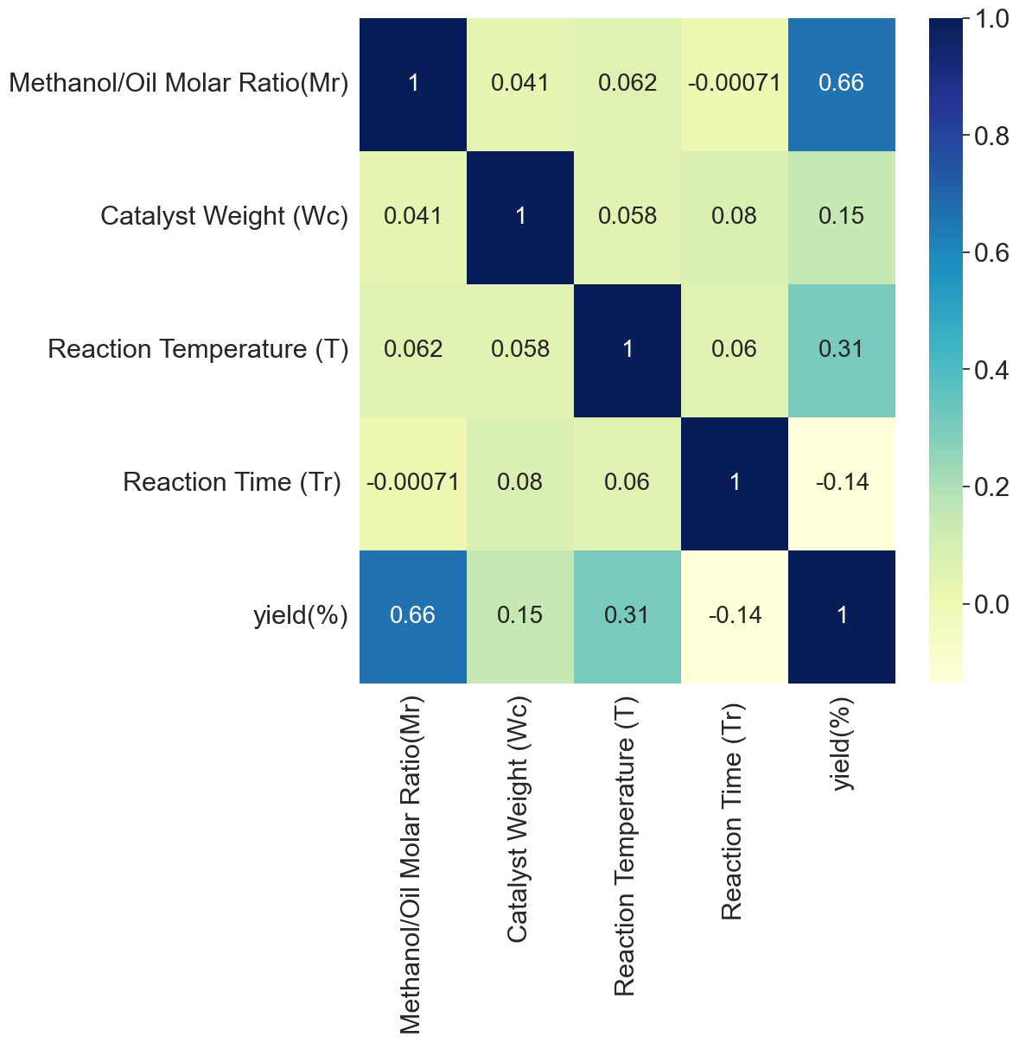
2) Pre-Analysis
Correlation plot: A correlation heatmap is a visual tool that displays the strength and direction of relationships between 17 variables in a dataset.

Slide 9
3) Modelling and Evaluation
Model for Prediction
1. XGBOOST Regressor: XGBoost (Extreme Gradient Boosting) regression is a powerful machine learning algorithm renowned for its exceptional predictive 18 performance in regression tasks.
2. XGBOOST Classifier: XGBoost (Extreme Gradient Boosting) classifier is a highly effective machine learning algorithm known for its exceptional performance in classification tasks.

Slide 10
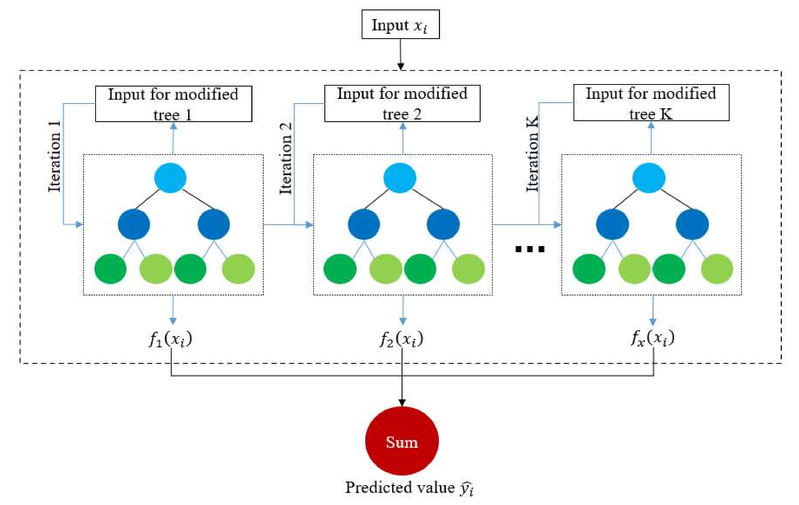
3) Modelling and Evaluation

Slide 11
3) Modelling and Evaluation
Evaluation Metrics
1. MAE: Mean Absolute Error (MAE) is a common metric used to measure the accuracy of a predictive model.
2. RMSE: Root Mean Squared Error (RMSE) is a common metric used to measure the accuracy of a predictive model.
3. MAPE: The Mean Absolute Percentage Error (MAPE) is a metric used to evaluate the accuracy of a forecasting or prediction model.
4. Precision: Precision is an essential evaluation metric for classification models.

Slide 12
Application of Machine Learning in Civil Engineering
1. Structural Health Monitoring
2. Predictive Maintenance
3. Geotechnical Engineering
4. Traffic Management
5. Environmental Impact Assessment

Slide 13
Learning through this Internship
Technical skills
Swift, memory management (ARC), python, Machine learning and SQL.
Built sample project, understood about reading and writing to the py files.
Learned about Model architecture, unit testing, SOLID principles and other design patterns (factory, singleton, dependency injection, delegate etc.).
Started contributing to the GoFood app and understood the process of deployment (making Jira cards, raising PR, resolving PR comments and merging PR etc.).
Soft skills
Made habit of attending every meeting (daily standups, lot of catch ups with Alam, crimson tech discussions, Townhall, MBR, QBR, crimson virtual coffee etc).
Understood the working flow of corporate industry.

Slide 14
Credit: Alam Hanza(Mentor) and GoFood team.
References:
https://www.gojek.com
https://developer.apple.com/documentation/uikit
https://www.hackingwithswift.com/quick-start/swiftui
https://forums.swift.org/
https://developer.apple.com/videos/wwdc2022/
https://www.youtube.com/c/CodeWithChri

Slide 15
Thank you
Q&A

